Slide 1





Modern JavaScript [ ES6++ ]
Writing
READING
SPEAKING
JOKING
// with Chayut Ruksomya

Slide 2
Table of content
What Node JS
NPM and package.json
JavaScript in nullshell

Slide 3


Slide 4
JavaScript
Runtime
Outside Web Browser

Slide 5
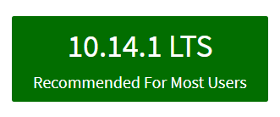
Install Node JS first
https://nodejs.org

Slide 6
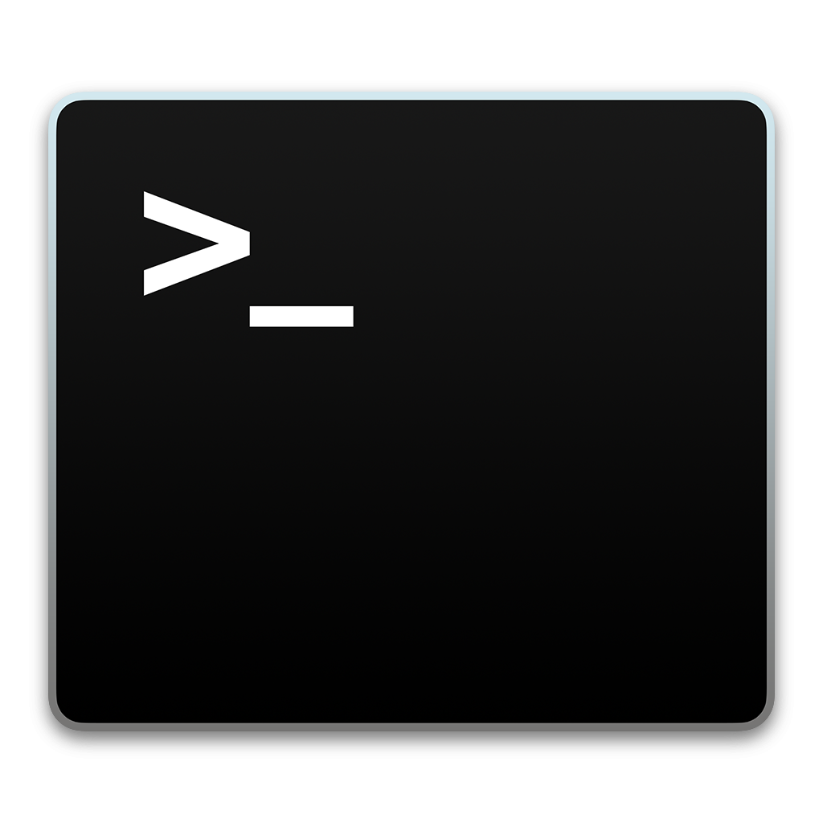
Verify
Installation
node -v

Slide 7
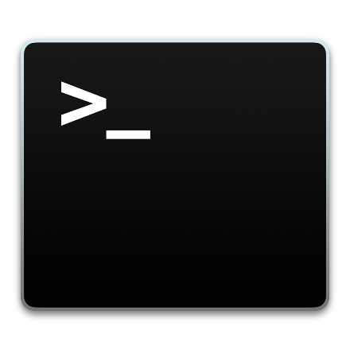
Code Example
CREATING SERVER USING JAVASCRIPT !!
var http = require('http');
var hostname = 'localhost';
var port = 3000;
var server = http.createServer(function (req, res) {
res.statusCode = 200;
res.setHeader('Content-Type', 'text/plain’);
res.end('hello from server!!');
});
server.listen(port, hostname, function () {
console.log('Server running at http://' + hostname + ':' + port);
});

Slide 8

Lab://001

Slide 9

Node Package Manager

Slide 10
The package manager for JavaScript and the world's largest software registry

Slide 11
What is npm?
Use npm to install, share, and distribute code; manage dependencies in your projects;

Slide 12
Verify
Installation
npm -v

Slide 13
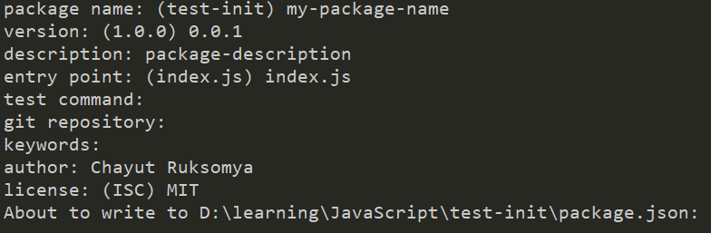
package.json and the very first npm command
npm init
// This command will create package.json file

Slide 14
{ "name": "my-package-name", "version": "0.0.1", "description": "package-description", "main": "index.js", "scripts": { "test": "echo \"Error: no test specified\" && exit 1" }, "author": "Chayut Ruksomya", "license": "MIT" }
package.json
The file in the root of your project source to use npm to install packages that your application requires (node modules).

Slide 15
To install dependency
npm install <package-name>
# or for short
npm i <package-name>
https://www.npmjs.com

Slide 16

Lab://002

Slide 17


ES2015
ECMAScript 2015

Slide 18

Intro to ES6

Slide 19
1. let var const
var -> function scope
let, const -> block scope

Slide 20
2. Template String
normal string “ ” or ‘ ’
Template String -> ` I’m template string ${JS expression} `
` -> Grave Accent

Slide 21
3. Arrow Function => ….
Traditional function syntax
Arrow function syntax(s)

Slide 22
4. rest and spread ( …variable )

Slide 23
5. destructuring

Slide 24
6. Functional programming??
Map
Filter
Reduce
Find

Slide 25

Lab://003

Slide 26
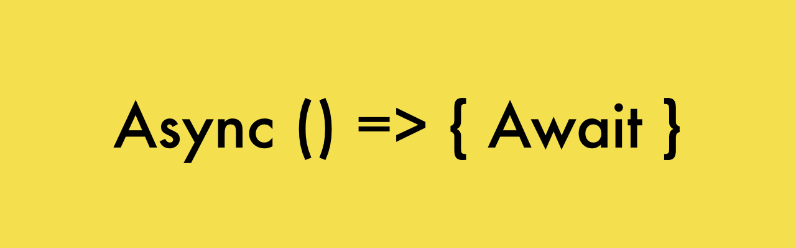
ES6 Advance

Slide 27
1. Callback VS Promise
Callback code
Promise code

Slide 28
2. Async Await
Async -> function
Await -> statement <- promise

Slide 29
3. Promise to Async await
Promise code
Async await code

Slide 30
4. Class

Slide 31

Lab://004

Slide 32
transpilers
polyfill

Slide 33
Installation with npm (mutiple dependency)
"devDependencies": {
"@babel/cli": "^7.1.5",
"@babel/core": "^7.1.6",
"@babel/preset-env": "^7.1.6"
},
"dependencies": {
"@babel/polyfill": "^7.0.0"
}
npm install [dependencies with space]
npm install @babel/cli @babel/core @babel/preset-env --save-dev
npm install @babel/polyfill

Slide 34
Transpilers is
Polyfill is

Slide 35
Import export modules (how to)

Slide 36
Workflow with Babel transpilers and node JS

Slide 37
But!! You can not Import export modules in browser

Slide 38

Lab://005

